Slide 2
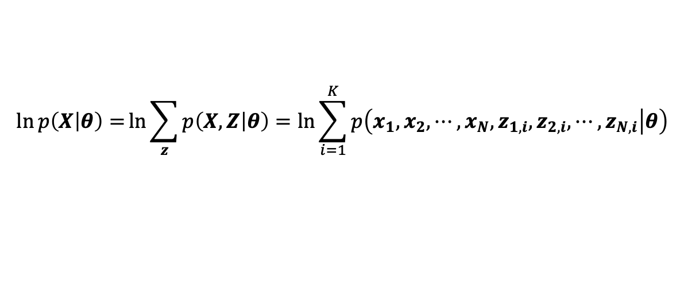






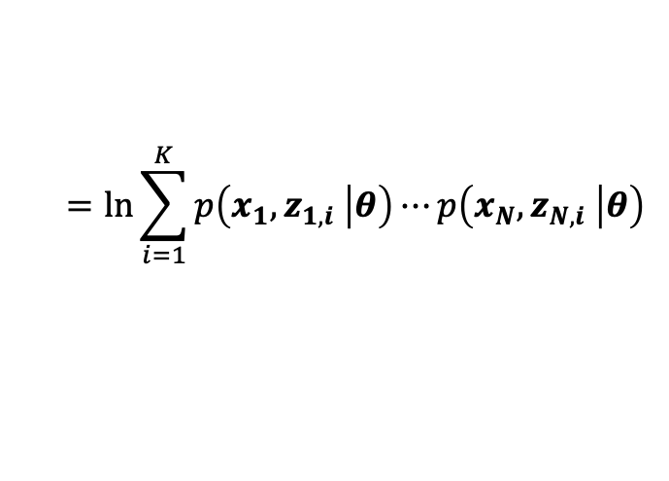


$$θ=\left\{π,A,φ\right\}$$
$$\ln{p\left(X | θ\right)=}\ln{\sum_{z}{p\left(X,Z | θ\right)}=\ln{\sum_{i=1}^{K}{p\left(x_{1},x_{2},⋯,x_{N},z_{1,i},z_{2,i},⋯,z_{N,i} | θ\right)}}}$$
$$π$$
$$z_{n}$$
$$=\ln{\sum_{i=1}^{K}{p\left(x_{1},z_{1,i} | θ\right)⋯p\left(x_{N},z_{N,i} | θ\right)}}$$
$$μ$$
$$Σ$$
$$x_{n}$$
$$=\ln{\sum_{i=1}^{K}{\prod_{n=1}^{N}{p\left(x_{n},z_{n,i} | θ\right)}}}$$
$$N$$
$$=\ln\left[p\left(x_{1},z_{1,1} | θ\right)⋯p\left(x_{N},z_{N,1} | θ\right)+⋯+p\left(x_{1},z_{1,K} | θ\right)⋯p\left(x_{N},z_{N,K} | θ\right)\right]$$

Slide 3
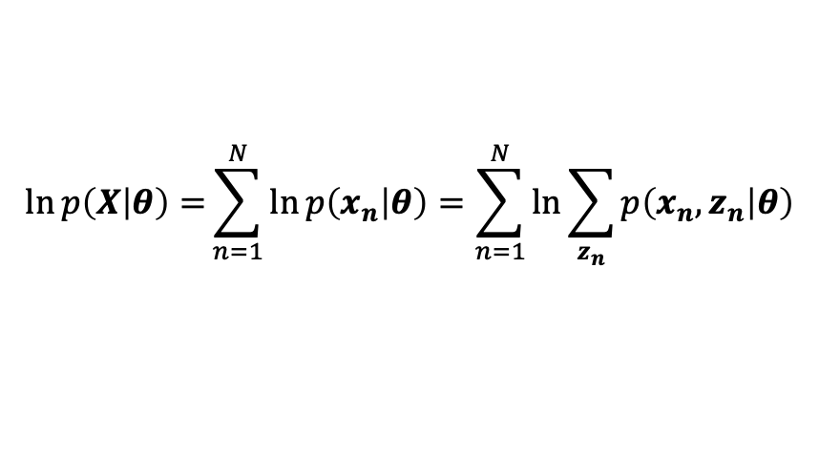
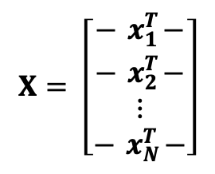


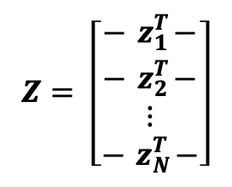
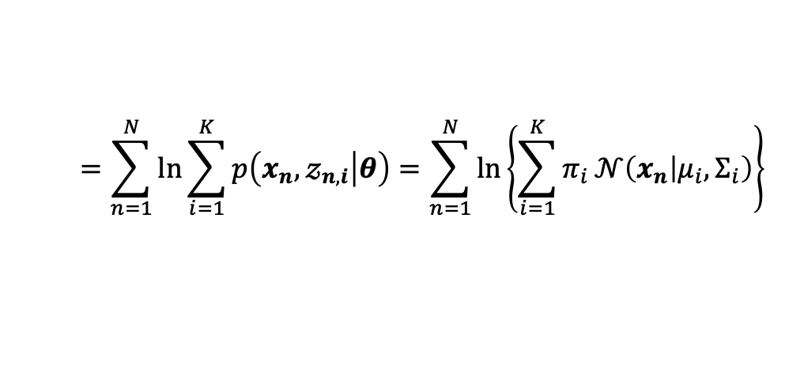


$$X= \left[\begin{matrix}−{ x}_{1}^{T}− \\ −{ x}_{2}^{T}− \\ \begin{aligned}⋮ \\ −{ x}_{N}^{T}−\end{aligned}\end{matrix}\right]$$
$$Z= \left[\begin{matrix}−{ z}_{1}^{T}− \\ −{ z}_{2}^{T}− \\ \begin{aligned}⋮ \\ −{ z}_{N}^{T}−\end{aligned}\end{matrix}\right]$$
$$π$$
$$x_{n}={\left[x_{n,1},x_{n,2},⋯,x_{n,D}\right]}^{T}$$
$$z_{n}={\left[𝓏_{n,1},𝓏_{n,2},⋯,𝓏_{n,K}\right]}^{T}$$
$$z_{n}$$
$$p\left(x\right)=\sum_{i=1}^{K}{π_{i}}𝒩\left(x | μ_{i},Σ_{i}\right)$$
$$μ$$
$$Σ$$
$$x_{n}$$
$$N$$
$$θ=\left\{π,A,φ\right\}$$
$$\ln{p\left(X | θ\right)=}\sum_{n=1}^{N}{\ln{p\left(x_{n} | θ\right)}}=\sum_{n=1}^{N}{\ln{\sum_{z_{n}}{p\left(x_{n},z_{n} | θ\right)}}}$$
$$=\sum_{n=1}^{N}{\ln{\sum_{i=1}^{K}{p\left(x_{n},𝓏_{n,i} | θ\right)}}}=\sum_{n=1}^{N}{\ln\left\{\sum_{i=1}^{K}{π_{i}}𝒩\left(x_{n} | μ_{i},Σ_{i}\right)\right\}}$$

Slide 4
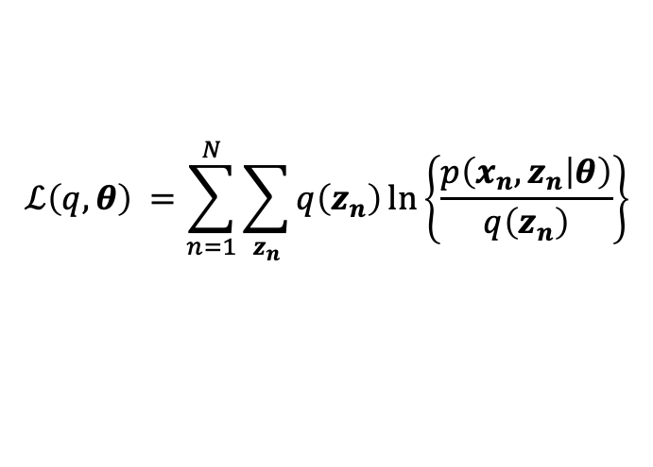
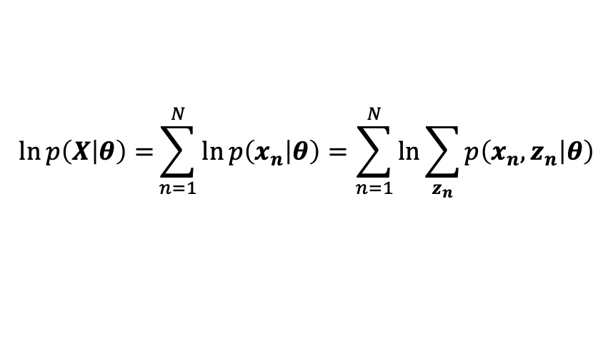
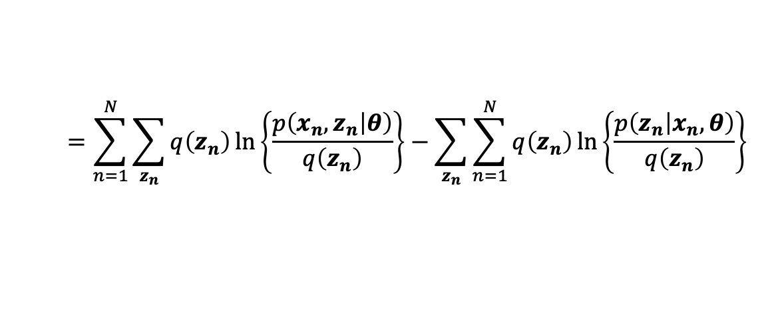

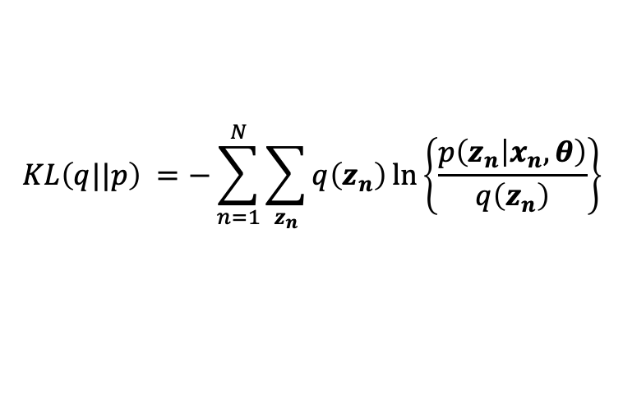
$$ℒ\left(q,θ\right) =\sum_{n=1}^{N}{\sum_{z_{n}}{q\left(z_{n}\right)\ln\left\{\frac{p\left(x_{n},z_{n} | θ\right)}{q\left(z_{n}\right)}\right\}}}$$
EM Algorithm
$$KL\left(q||p\right) =−\sum_{n=1}^{N}{\sum_{z_{n}}{q\left(z_{n}\right)\ln\left\{\frac{p\left(z_{n} | x_{n},θ\right)}{q\left(z_{n}\right)}\right\}}}$$
$$\ln{p\left(X | θ\right)=}\sum_{n=1}^{N}{\ln{p\left(x_{n} | θ\right)}}=\sum_{n=1}^{N}{\ln{\sum_{z_{n}}{p\left(x_{n},z_{n} | θ\right)}}}$$
$$=\sum_{n=1}^{N}{\sum_{z_{n}}{q\left(z_{n}\right)\ln\left\{\frac{p\left(x_{n},z_{n} | θ\right)}{q\left(z_{n}\right)}\right\}}}−\sum_{z_{n}}{\sum_{n=1}^{N}{q\left(z_{n}\right)\ln\left\{\frac{p\left(z_{n} | x_{n},θ\right)}{q\left(z_{n}\right)}\right\}}}$$
$$=ℒ\left(q,θ\right)+KL\left(q||p\right)$$

Slide 5

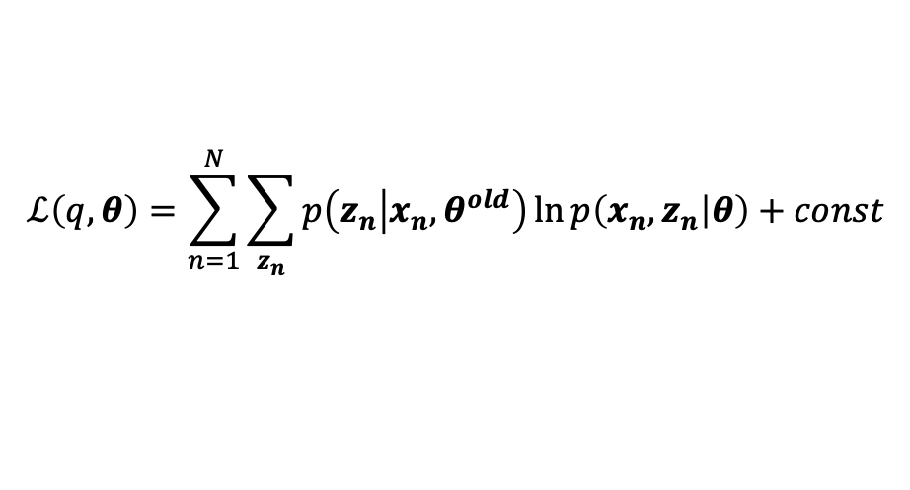
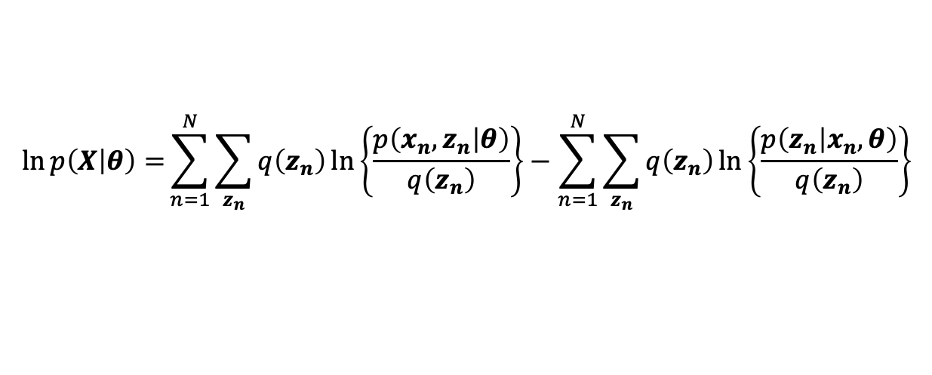




EM Algorithm
$$π$$
$$z_{n}$$
$$\ln{p\left(X | θ\right)=}\sum_{n=1}^{N}{\sum_{z_{n}}{q\left(z_{n}\right)\ln\left\{\frac{p\left(x_{n},z_{n} | θ\right)}{q\left(z_{n}\right)}\right\}}}−\sum_{n=1}^{N}{\sum_{z_{n}}{q\left(z_{n}\right)\ln\left\{\frac{p\left(z_{n} | x_{n},θ\right)}{q\left(z_{n}\right)}\right\}}}$$
$$μ$$
$$Σ$$
$$x_{n}$$
$$=ℒ\left(q,θ\right)+KL\left(q||p\right)$$
$$N$$
E-step :
$$KL\left(q||p\right)=0$$
$$q\left(z_{n}\right)=p\left(z_{n} | x_{n}, θ^{old}\right)$$
$$q\left(z_{n}\right)를 정의?$$
$$ℒ\left(q,θ\right)=\sum_{n=1}^{N}{\sum_{z_{n}}{p\left(z_{n} | x_{n}, θ^{old}\right)\ln{p\left(x_{n},z_{n} | θ\right)}}}+const$$
M-step :
$$θ^{new}=\underset{θ}{arg max}{ℒ\left(q,θ\right)}$$

Slide 6

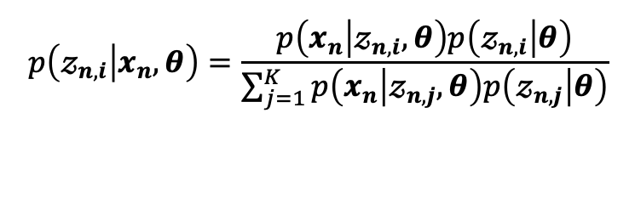
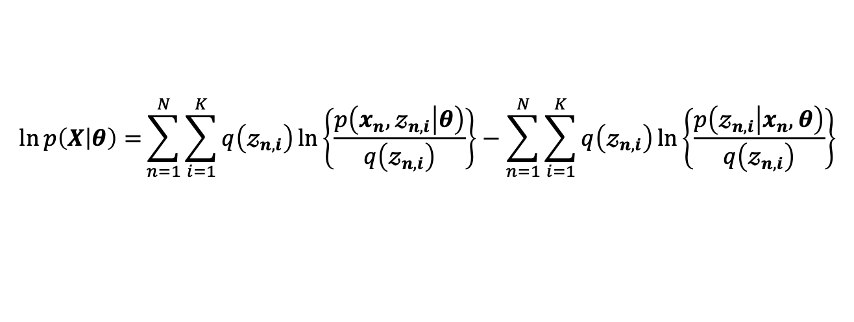
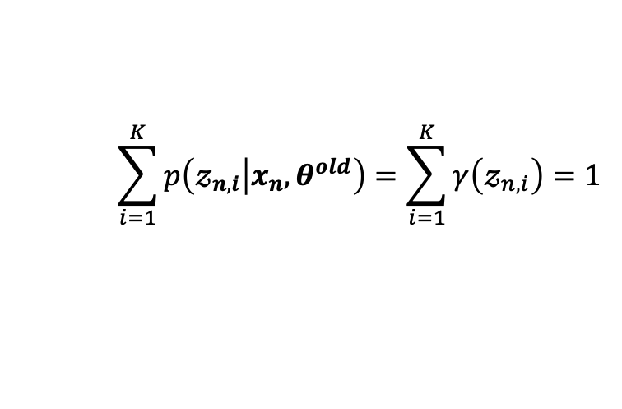

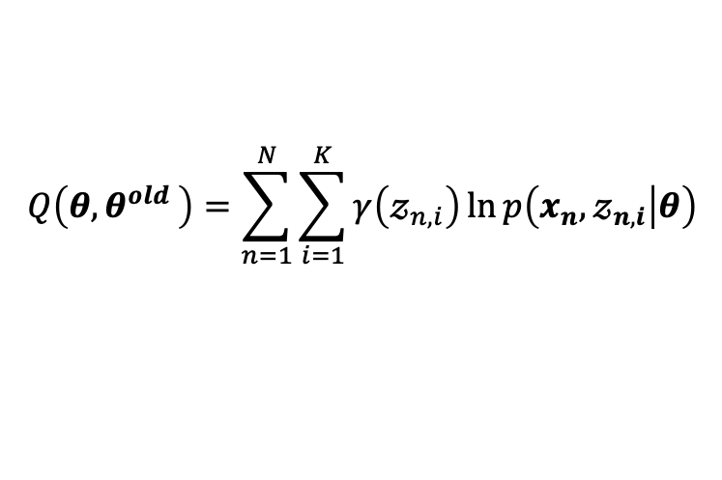

EM Algorithm
$$θ=\left\{π,A,φ\right\}$$
$$π$$
$$z_{n}$$
$$\ln{p\left(X | θ\right)=}\sum_{n=1}^{N}{\sum_{i=1}^{K}{q\left(𝓏_{n,i}\right)\ln\left\{\frac{p\left(x_{n},𝓏_{n,i} | θ\right)}{q\left(𝓏_{n,i}\right)}\right\}}}−\sum_{n=1}^{N}{\sum_{i=1}^{K}{q\left(𝓏_{n,i}\right)\ln\left\{\frac{p\left(𝓏_{n,i} | x_{n},θ\right)}{q\left(𝓏_{n,i}\right)}\right\}}}$$
$$μ$$
$$Σ$$
$$x_{n}$$
$$=ℒ\left(q,θ\right)+KL\left(q||p\right)$$
$$N$$
E-step :
$$γ\left(𝓏_{n,i}\right)≡q\left(𝓏_{n,i}\right)=p\left(𝓏_{n,i} | x_{n}, θ^{old}\right) → constant$$
$$p\left(𝓏_{n,i} | x_{n},θ\right)=\frac{p\left(x_{n} | 𝓏_{n,i},θ\right)p\left(𝓏_{n,i} | θ\right)}{\sum_{j=1}^{K}{p\left(x_{n} | 𝓏_{n,j},θ\right)p\left(𝓏_{n,j} | θ\right)}}$$
$$\sum_{i=1}^{K}{p\left(𝓏_{n,i} | x_{n}, θ^{old}\right)}=\sum_{i=1}^{K}{γ\left(𝓏_{n,i}\right)}=1$$
M-step :
$$θ^{new}=\underset{θ}{arg max}{Q\left(θ{,θ}^{old}\right) }$$
$p\left(x_{n},𝓏_{n,i} | θ\right)=$ $p\left(x_{n} | 𝓏_{n,i},θ\right)p\left(𝓏_{n,i} | θ\right)$
$$Q\left(θ{,θ}^{old}\right)=\sum_{n=1}^{N}{\sum_{i=1}^{K}{γ\left(𝓏_{n,i}\right)\ln{p\left(x_{n},𝓏_{n,i} | θ\right)}}}$$

Slide 7

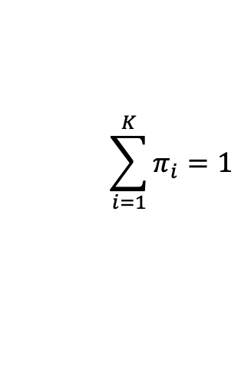


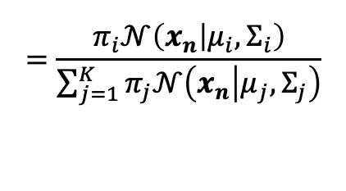

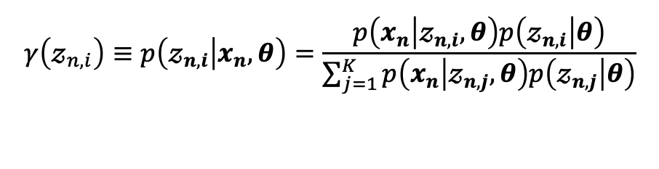
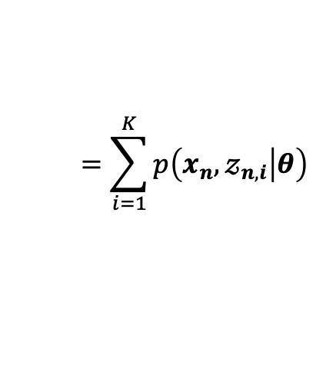

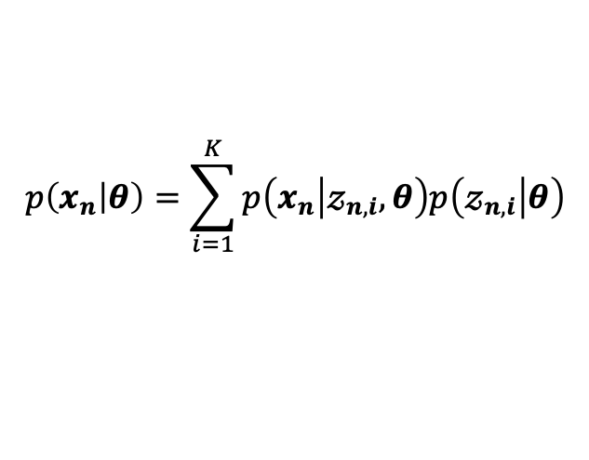
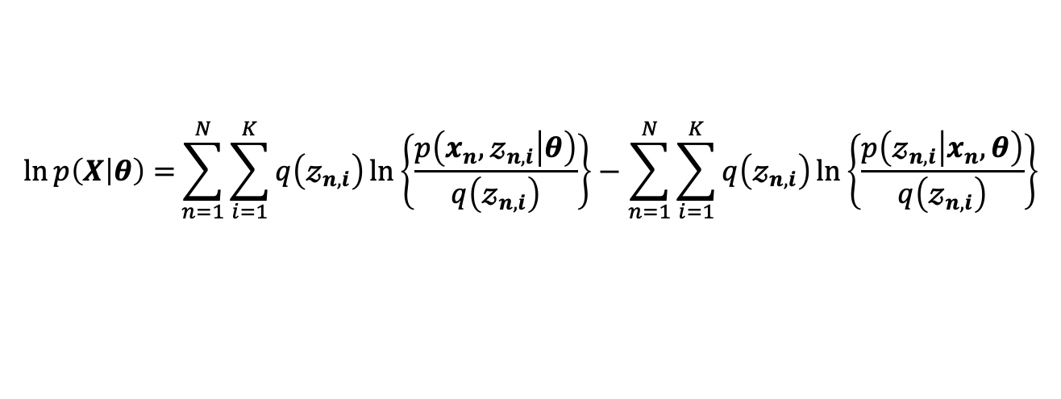
EM Algorithm을 가우시안 혼합 모델에 적용
$$π$$
$$z_{n}$$
$$θ=\left\{π,A,φ\right\}$$
$$\ln{p\left(X | θ\right)=}\sum_{n=1}^{N}{\sum_{i=1}^{K}{q\left(𝓏_{n,i}\right)\ln\left\{\frac{p\left(x_{n},𝓏_{n,i} | θ\right)}{q\left(𝓏_{n,i}\right)}\right\}}}−\sum_{n=1}^{N}{\sum_{i=1}^{K}{q\left(𝓏_{n,i}\right)\ln\left\{\frac{p\left(𝓏_{n,i} | x_{n},θ\right)}{q\left(𝓏_{n,i}\right)}\right\}}}$$
$$μ$$
$$Σ$$
$$x_{n}$$
$$N$$
$p\left(x_{n},𝓏_{n,i} | θ\right)=$ $π_{i}𝒩\left(x_{n} | μ_{i},Σ_{i}\right)$
$$p\left(x_{n} | θ\right)=\sum_{i=1}^{K}{p\left(x_{n} | 𝓏_{n,i},θ\right)p\left(𝓏_{n,i} | θ\right)}$$
$$p\left(x_{n} | 𝓏_{n,i},θ\right)=𝒩\left(x_{n} | μ_{i},Σ_{i}\right)$$
$$\sum_{i=1}^{K}{π_{i}}=1$$
$$=\sum_{i=1}^{K}{p\left(x_{n},𝓏_{n,i} | θ\right)}$$
$$p\left(𝓏_{n,i} | θ\right)=π_{i}$$
$$γ\left(𝓏_{n,i}\right)≡p\left(𝓏_{n,i} | x_{n},θ\right)=\frac{p\left(x_{n} | 𝓏_{n,i},θ\right)p\left(𝓏_{n,i} | θ\right)}{\sum_{j=1}^{K}{p\left(x_{n} | 𝓏_{n,j},θ\right)p\left(𝓏_{n,j} | θ\right)}}$$
$$=\sum_{i=1}^{K}{π_{i}}𝒩\left(x_{n} | μ_{i},Σ_{i}\right)$$
$$=\frac{π_{i}𝒩\left(x_{n} | μ_{i},Σ_{i}\right)}{\sum_{j=1}^{K}{π_{j}𝒩\left(x_{n} | μ_{j},Σ_{j}\right)}}$$

Slide 8

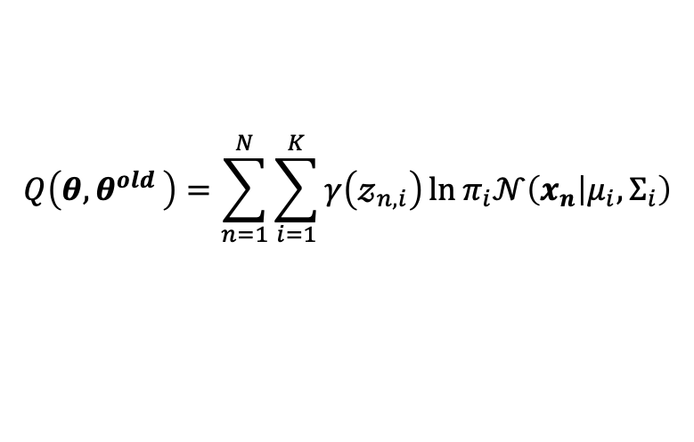
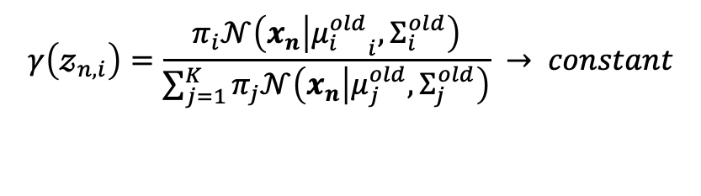
EM Algorithm을 가우시안 혼합 모델에 적용
$$π$$
$$z_{n}$$
$$θ=\left\{π,A,φ\right\}$$
$$\ln{p\left(X | θ\right)=}\sum_{n=1}^{N}{\sum_{i=1}^{K}{q\left(𝓏_{n,i}\right)\ln\left\{\frac{p\left(x_{n},𝓏_{n,i} | θ\right)}{q\left(𝓏_{n,i}\right)}\right\}}}−\sum_{n=1}^{N}{\sum_{i=1}^{K}{q\left(𝓏_{n,i}\right)\ln\left\{\frac{p\left(𝓏_{n,i} | x_{n},θ\right)}{q\left(𝓏_{n,i}\right)}\right\}}}$$
$$μ$$
$$Σ$$
$$x_{n}$$
$$N$$
$$γ\left(𝓏_{n,i}\right)=\frac{π_{i}𝒩\left(x_{n} | {μ_{i}^{old}}_{i},Σ_{i}^{old}\right)}{\sum_{j=1}^{K}{π_{j}𝒩\left(x_{n} | μ_{j}^{old},Σ_{j}^{old}\right)}} → constant$$
E-step :
$$KL\left(q||p\right)=0$$
$$Q\left(θ{,θ}^{old}\right)=\sum_{n=1}^{N}{\sum_{i=1}^{K}{γ\left(𝓏_{n,i}\right)\ln{π_{i}𝒩\left(x_{n} | μ_{i},Σ_{i}\right)}}}$$
M-step :
$$θ^{new}=\underset{θ}{arg max}{Q\left(θ{,θ}^{old}\right) }$$

Slide 9

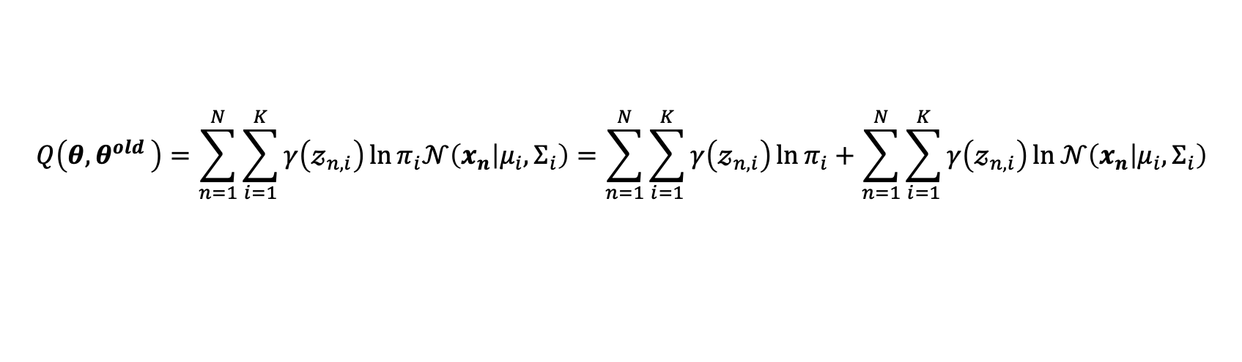
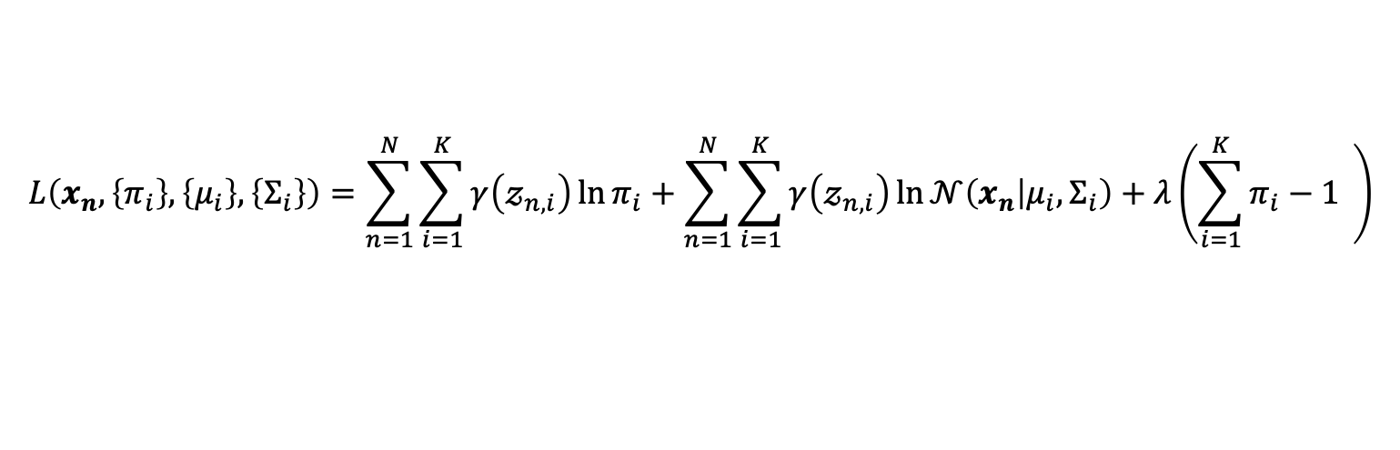
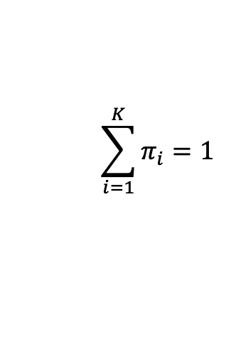
EM Algorithm을 가우시안 혼합 모델에 적용
M-step :
$$θ^{new}=\underset{θ}{arg max}{Q\left(θ{,θ}^{old}\right) }$$
$$\sum_{i=1}^{K}{π_{i}}=1$$
$$Q\left(θ{,θ}^{old}\right)=\sum_{n=1}^{N}{\sum_{i=1}^{K}{γ\left(𝓏_{n,i}\right)\ln{π_{i}𝒩\left(x_{n} | μ_{i},Σ_{i}\right)}}}=\sum_{n=1}^{N}{\sum_{i=1}^{K}{γ\left(𝓏_{n,i}\right)\ln{π_{i}}}}+\sum_{n=1}^{N}{\sum_{i=1}^{K}{γ\left(𝓏_{n,i}\right)\ln{𝒩\left(x_{n} | μ_{i},Σ_{i}\right)}}}$$
$$L\left(x_{n}, \left\{π_{i}\right\},\left\{μ_{i}\right\},\left\{Σ_{i}\right\}\right)=\sum_{n=1}^{N}{\sum_{i=1}^{K}{γ\left(𝓏_{n,i}\right)\ln{π_{i}}}}+\sum_{n=1}^{N}{\sum_{i=1}^{K}{γ\left(𝓏_{n,i}\right)\ln{𝒩\left(x_{n} | μ_{i},Σ_{i}\right)}}}+λ\left(\sum_{i=1}^{K}{π_{i}}−1 \right)$$

Slide 10

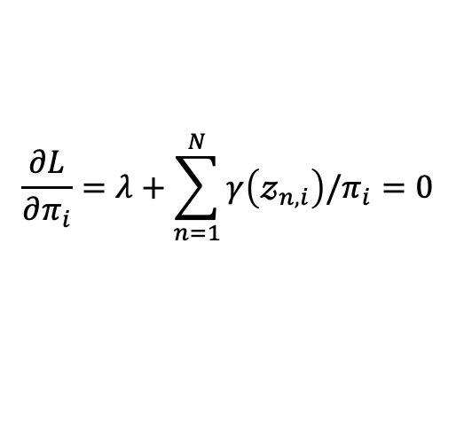
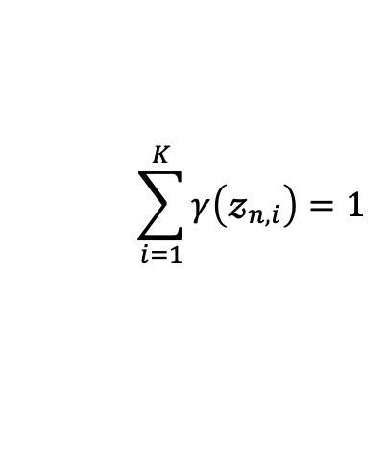
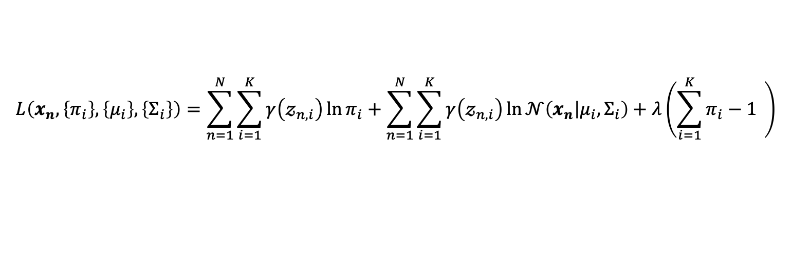
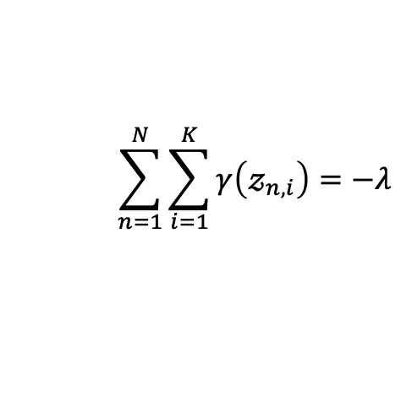
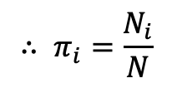
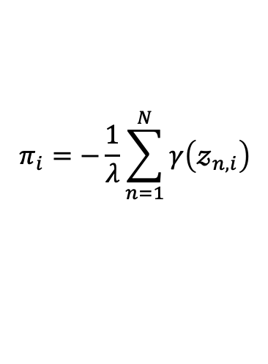
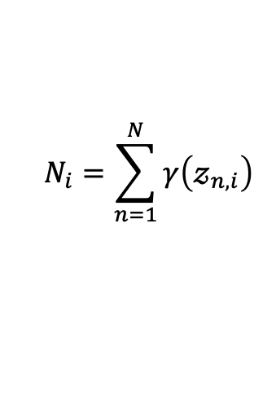
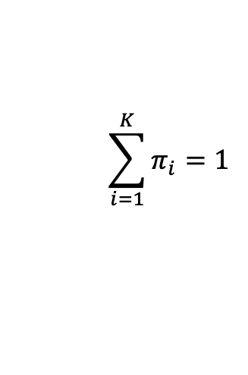
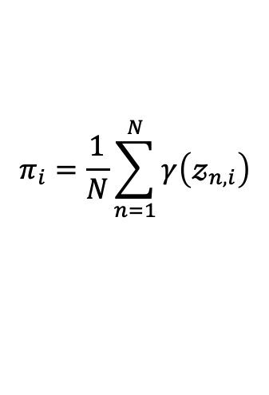
EM Algorithm을 가우시안 혼합 모델에 적용
$$L\left(x_{n}, \left\{π_{i}\right\},\left\{μ_{i}\right\},\left\{Σ_{i}\right\}\right)=\sum_{n=1}^{N}{\sum_{i=1}^{K}{γ\left(𝓏_{n,i}\right)\ln{π_{i}}}}+\sum_{n=1}^{N}{\sum_{i=1}^{K}{γ\left(𝓏_{n,i}\right)\ln{𝒩\left(x_{n} | μ_{i},Σ_{i}\right)}}}+λ\left(\sum_{i=1}^{K}{π_{i}}−1 \right)$$
$$\frac{∂L}{∂π_{i}}=λ+\sum_{n=1}^{N}{γ\left(𝓏_{n,i}\right)/π_{i}}=0$$
$$π_{i}=\frac{1}{N}\sum_{n=1}^{N}{γ\left(𝓏_{n,i}\right)}$$
$$N_{i}=\sum_{n=1}^{N}{γ\left(𝓏_{n,i}\right)}$$
$$π_{i}=−\frac{1}{λ}\sum_{n=1}^{N}{γ\left(𝓏_{n,i}\right)}$$
$$\sum_{i=1}^{K}{π_{i}}=1$$
$$\sum_{n=1}^{N}{\sum_{i=1}^{K}{γ\left(𝓏_{n,i}\right)}}=−λ$$
$$\sum_{i=1}^{K}{γ\left(𝓏_{n,i}\right)}=1$$
$$∴ π_{i}=\frac{N_{i}}{N}$$
$$−λ=N$$

Slide 11
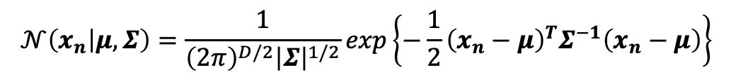
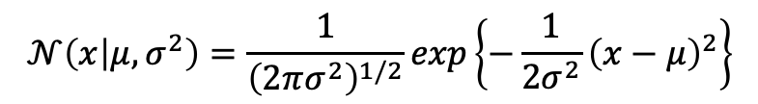
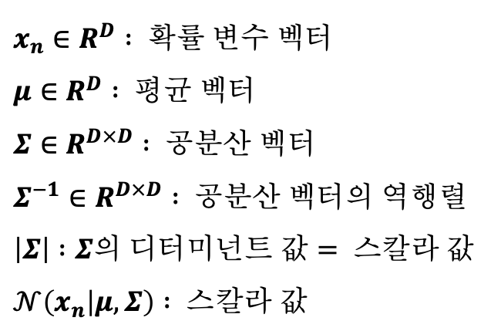
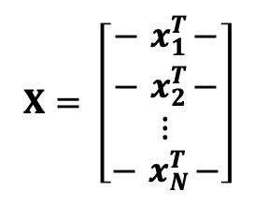

EM Algorithm을 가우시안 혼합 모델에 적용
전에 가우시안 분포
$$X= \left[\begin{matrix}−{ x}_{1}^{T}− \\ −{ x}_{2}^{T}− \\ \begin{aligned}⋮ \\ −{ x}_{N}^{T}−\end{aligned}\end{matrix}\right]$$
$$x_{n}={\left[x_{n,1},x_{n,2},⋯,x_{n,D}\right]}^{T}$$
$$𝒩\left(x | μ,σ^{2}\right)=\frac{1}{{\left(2πσ^{2}\right)}^{1/2}}exp\left\{−\frac{1}{2σ^{2}}{\left(x−μ\right)}^{2}\right\}$$
$x_{n}∈R^{D} : 확률 변수 벡터$
$μ∈R^{D} : 평균 벡터$
$Σ∈R^{D×D} : 공분산 벡터$
$Σ^{−1}∈R^{D×D} : 공분산 벡터의 역행렬$
$\left|Σ\right| :Σ의 디터미넌트 값= 스칼라 값$
$𝒩\left(x_{n} | μ,Σ\right) : 스칼라 값$
$$𝒩\left(x_{n} | μ,Σ\right)=\frac{1}{{\left(2π\right)}^{D/2}{\left|Σ\right|}^{1/2}}exp\left\{−\frac{1}{2}{\left(x_{n}−μ\right)}^{T}Σ^{−1}\left(x_{n}−μ\right)\right\}$$

Slide 12
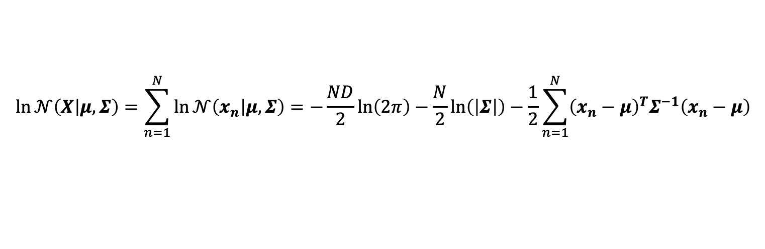
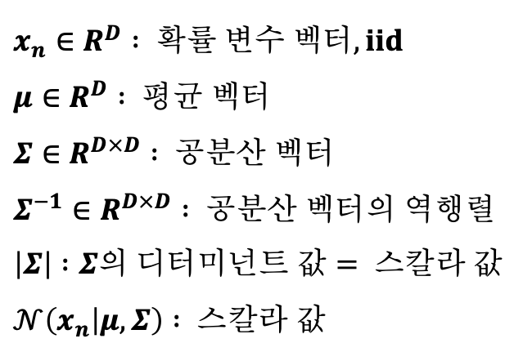
EM Algorithm을 가우시안 혼합 모델에 적용
전에 가우시안 분포
$$X= \left[\begin{matrix}−{ x}_{1}^{T}− \\ −{ x}_{2}^{T}− \\ \begin{aligned}⋮ \\ −{ x}_{N}^{T}−\end{aligned}\end{matrix}\right]$$
$$x_{n}={\left[x_{n,1},x_{n,2},⋯,x_{n,D}\right]}^{T}$$
$$𝒩\left(x | μ,σ^{2}\right)=\frac{1}{{\left(2πσ^{2}\right)}^{1/2}}exp\left\{−\frac{1}{2σ^{2}}{\left(x−μ\right)}^{2}\right\}$$
$x_{n}∈R^{D} : 확률 변수 벡터, iid$
$μ∈R^{D} : 평균 벡터$
$Σ∈R^{D×D} : 공분산 벡터$
$Σ^{−1}∈R^{D×D} : 공분산 벡터의 역행렬$
$\left|Σ\right| :Σ의 디터미넌트 값= 스칼라 값$
$𝒩\left(x_{n} | μ,Σ\right) : 스칼라 값$
$$𝒩\left(x_{n} | μ,Σ\right)=\frac{1}{{\left(2π\right)}^{D/2}{\left|Σ\right|}^{1/2}}exp\left\{−\frac{1}{2}{\left(x_{n}−μ\right)}^{T}Σ^{−1}\left(x_{n}−μ\right)\right\}$$
$$\ln{𝒩\left(x_{n} | μ,Σ\right)}=−\frac{D}{2}ln\left(2π\right)−\frac{1}{2}ln\left(\left|Σ\right|\right)−\frac{1}{2}{\left(x_{n}−μ\right)}^{T}Σ^{−1}\left(x_{n}−μ\right)$$
$$\ln{𝒩\left(X | μ,Σ\right)}=\sum_{n=1}^{N}{\ln{𝒩\left(x_{n} | μ,Σ\right)}}=−\frac{ND}{2}ln\left(2π\right)−\frac{N}{2}ln\left(\left|Σ\right|\right)−\frac{1}{2}\sum_{n=1}^{N}{{\left(x_{n}−μ\right)}^{T}Σ^{−1}\left(x_{n}−μ\right)}$$

Slide 13
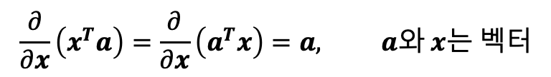
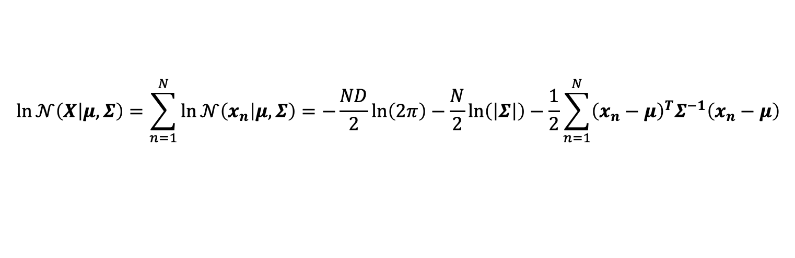
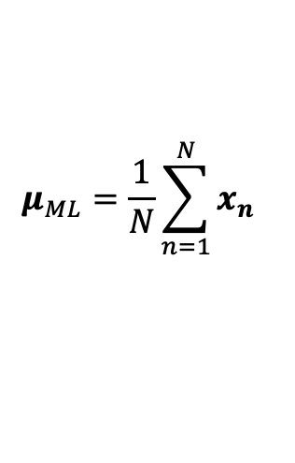
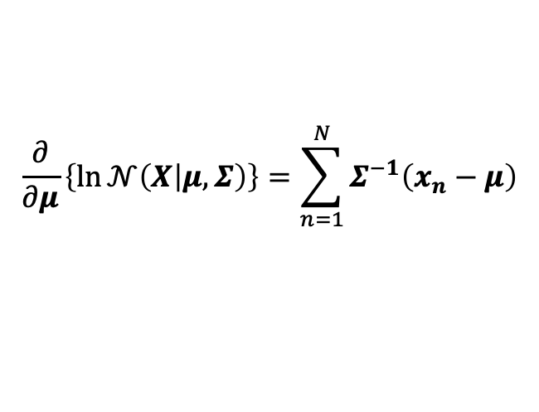
EM Algorithm을 가우시안 혼합 모델에 적용
전에 가우시안 분포
$$\ln{𝒩\left(X | μ,Σ\right)}=\sum_{n=1}^{N}{\ln{𝒩\left(x_{n} | μ,Σ\right)}}=−\frac{ND}{2}ln\left(2π\right)−\frac{N}{2}ln\left(\left|Σ\right|\right)−\frac{1}{2}\sum_{n=1}^{N}{{\left(x_{n}−μ\right)}^{T}Σ^{−1}\left(x_{n}−μ\right)}$$
$$\frac{∂}{∂μ}\left\{\ln{𝒩\left(X | μ,Σ\right)}\right\}=\sum_{n=1}^{N}{Σ^{−1}\left(x_{n}−μ\right)}$$
$$\frac{∂}{∂x}\left(x^{T}a\right)=\frac{∂}{∂x}\left(a^{T}x\right)=a, a와 x는 벡터$$
$$μ_{ML}=\frac{1}{N}\sum_{n=1}^{N}{x_{n}}$$

Slide 14
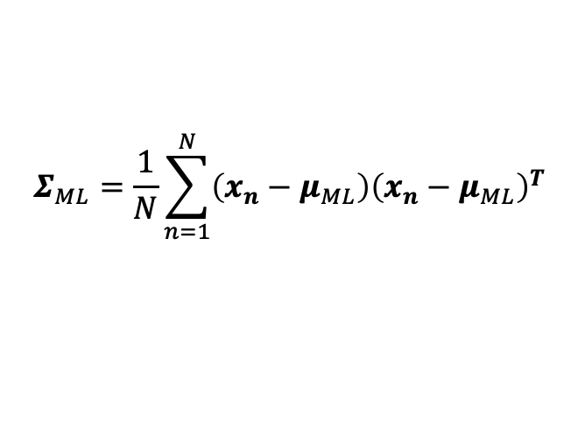






EM Algorithm을 가우시안 혼합 모델에 적용
전에 가우시안 분포
$$\ln{𝒩\left(X | μ,Σ\right)}=\sum_{n=1}^{N}{\ln{𝒩\left(x_{n} | μ,Σ\right)}}=−\frac{ND}{2}ln\left(2π\right)−\frac{N}{2}ln\left(\left|Σ\right|\right)−\frac{1}{2}\sum_{n=1}^{N}{{\left(x_{n}−μ\right)}^{T}Σ^{−1}\left(x_{n}−μ\right)}$$
$$\frac{∂}{∂Σ}\left\{\ln{𝒩\left(X | μ,Σ\right)}\right\}=\frac{∂}{∂Σ}\left\{−\frac{N}{2}ln\left(\left|Σ\right|\right)\right\}+\frac{∂}{∂Σ}\left\{−\frac{1}{2}\sum_{n=1}^{N}{{\left(x_{n}−μ\right)}^{T}Σ^{−1}\left(x_{n}−μ\right)}\right\}$$
$$\frac{∂}{∂x}\left(x^{T}a\right)=\frac{∂}{∂x}\left(a^{T}x\right)=a, a와 x는 벡터$$
$$Σ_{ML}=\frac{1}{N}\sum_{n=1}^{N}{{\left(x_{n}−μ_{ML}\right)\left(x_{n}−μ_{ML}\right)}^{T}}$$
$$\frac{∂}{∂x}\left(A^{−1}\right)=A^{−1}\frac{∂A}{∂x}A^{−1}, A는 행렬, x는 스칼라$$
$$\frac{∂}{∂A}Tr\left(A\right)=I$$
$$\frac{∂}{∂A}\ln\left|A\right|={\left(A^{−1}\right)}^{T}$$

Slide 15




EM Algorithm을 가우시안 혼합 모델에 적용
$$L\left(x_{n}, \left\{π_{i}\right\},\left\{μ_{i}\right\},\left\{Σ_{i}\right\}\right)=\sum_{n=1}^{N}{\sum_{i=1}^{K}{γ\left(𝓏_{n,i}\right)\ln{π_{i}}}}+\sum_{n=1}^{N}{\sum_{i=1}^{K}{γ\left(𝓏_{n,i}\right)\ln{𝒩\left(x_{n} | μ_{i},Σ_{i}\right)}}}+λ\left(\sum_{i=1}^{K}{π_{i}}−1 \right)$$
$$\frac{∂L}{∂μ_{i}}=\frac{∂}{∂μ_{i}}\left\{\sum_{n=1}^{N}{\sum_{i=1}^{K}{γ\left(𝓏_{n,i}\right)\ln{𝒩\left(x_{n} | μ_{i},Σ_{i}\right)}}}\right\}$$
$$\frac{∂L}{∂Σ_{i}}=\frac{∂}{∂Σ_{i}}\left\{\sum_{n=1}^{N}{\sum_{i=1}^{K}{γ\left(𝓏_{n,i}\right)\ln{𝒩\left(x_{n} | μ_{i},Σ_{i}\right)}}}\right\}$$
$$μ_{i}=\frac{1}{N_{i}}\sum_{n=1}^{N}{γ\left(𝓏_{n,i}\right)x_{n}}$$
$$Σ_{i}=\frac{1}{N_{i}}\sum_{n=1}^{N}{{γ\left(𝓏_{n,i}\right)\left(x_{n}−μ_{i}\right)\left(x_{n}−μ_{i}\right)}^{T}}$$

Slide 16







EM Algorithm을 가우시안 혼합 모델에 적용
$$π$$
$$z_{n}$$
$$\ln{p\left(X | θ\right)=}\sum_{n=1}^{N}{\sum_{i=1}^{K}{q\left(𝓏_{n,i}\right)\ln\left\{\frac{p\left(x_{n},𝓏_{n,i} | θ\right)}{q\left(𝓏_{n,i}\right)}\right\}}}−\sum_{n=1}^{N}{\sum_{i=1}^{K}{q\left(𝓏_{n,i}\right)\ln\left\{\frac{p\left(𝓏_{n,i} | x_{n},θ\right)}{q\left(𝓏_{n,i}\right)}\right\}}}$$
$$μ$$
$$Σ$$
$$x_{n}$$
$$N$$
$$γ\left(𝓏_{n,i}\right)=\frac{π_{i}𝒩\left(x_{n} | {μ_{i}^{old}}_{i},Σ_{i}^{old}\right)}{\sum_{j=1}^{K}{π_{j}𝒩\left(x_{n} | μ_{j}^{old},Σ_{j}^{old}\right)}}$$
E-step :
$$π_{i}^{new} =\frac{N_{i}}{N}$$
$$N_{i}=\sum_{n=1}^{N}{γ\left(𝓏_{n,i}\right)}$$
M-step :
$$μ_{i}^{new}=\frac{1}{N_{i}}\sum_{n=1}^{N}{γ\left(𝓏_{n,i}\right)x_{n}}$$
$$θ=\left\{π,μ,Σ\right\}$$
$$Σ_{i}^{new}=\frac{1}{N_{i}}\sum_{n=1}^{N}{{γ\left(𝓏_{n,i}\right)\left(x_{n}−μ_{i}\right)\left(x_{n}−μ_{i}\right)}^{T}}$$

Slide 17
EM Algorithm을 가우시안 혼합 모델에 적용

Slide 18











$$θ=\left\{π,A,φ\right\}$$
$$X= \left[\begin{matrix}−{ x}_{1}^{T}− \\ −{ x}_{2}^{T}− \\ \begin{aligned}⋮ \\ −{ x}_{N}^{T}−\end{aligned}\end{matrix}\right]=\left[\begin{matrix}x_{1,1} & x_{1,2} & ⋯ & x_{1,D} \\ x_{2,1} & x_{2,2} & ⋯ & x_{2,D} \\ ⋮ & ⋮ & ⋱ & ⋮ \\ x_{N,1} & x_{N,2} & ⋯ & x_{N,D}\end{matrix}\right]$$
$$Z= \left[\begin{matrix}−{ z}_{1}^{T}− \\ −{ z}_{2}^{T}− \\ \begin{aligned}⋮ \\ −{ z}_{N}^{T}−\end{aligned}\end{matrix}\right]=\left[\begin{matrix}𝓏_{1,1} & 𝓏_{1,2} & ⋯ & 𝓏_{1,K} \\ 𝓏_{2,1} & 𝓏_{2,2} & ⋯ & 𝓏_{2,K} \\ ⋮ & ⋮ & ⋱ & ⋮ \\ 𝓏_{N,1} & 𝓏_{N,2} & ⋯ & 𝓏_{N,K}\end{matrix}\right]$$
$$Z=\left\{{ z}_{1}^{T},{ z}_{2}^{T},⋯,{ z}_{N}^{T}\right\}$$
$$x_{n}={\left[x_{n,1},x_{n,2},⋯,x_{n,D}\right]}^{T}$$
$$z_{n}={\left[𝓏_{n,1},𝓏_{n,2},⋯,𝓏_{n,K}\right]}^{T}$$
$$\ln{p\left(X | θ\right)=}ln\left\{\sum_{Z}{p\left(X,Z | θ\right)}\right\}{=\ln\left\{\sum_{Z}{p\left(x_{1},x_{2},⋯,x_{N},z_{1},z_{2},⋯,z_{N} | θ\right)}\right\}}$$
$$=\ln\left\{\sum_{z_{1}}{\sum_{z_{2}}{⋯\sum_{z_{N}}{p\left(x_{1},x_{2},⋯,x_{N},z_{1},z_{2},⋯,z_{N} | θ\right)}}}\right\}$$
$$\ln{p\left(X | θ\right)}=\sum_{Z}{q\left(Z\right)\ln{\frac{p\left(X,Z | θ\right)}{q\left(Z\right)}}}−\sum_{Z}{q\left(Z\right)\ln{\frac{p\left(Z | X,θ\right)}{q\left(Z\right)}}}$$
$$ℒ\left(q,θ\right)=\sum_{Z}{q\left(Z\right)\ln{\frac{p\left(X,Z | θ\right)}{q\left(Z\right)}}}$$
$$Q\left(θ{,θ}^{old}\right)=\sum_{Z}{p\left(Z | X,θ^{old}\right)\ln{p\left(X,Z | θ\right)}}$$
$$KL\left(q||p\right)=−\sum_{Z}{q\left(Z\right)\ln{\frac{p\left(Z | X,θ\right)}{q\left(Z\right)}}}$$

